Slide 1

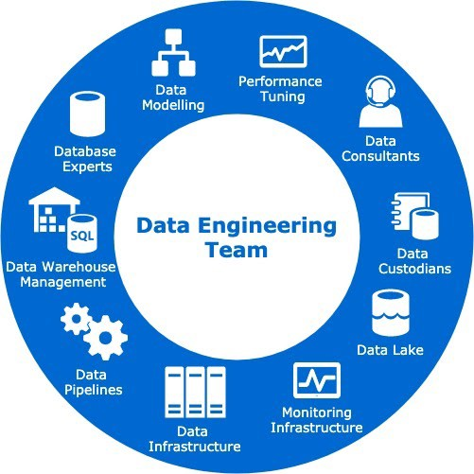
Technical
Assessment
By - Anubhav Rastogi

Slide 2
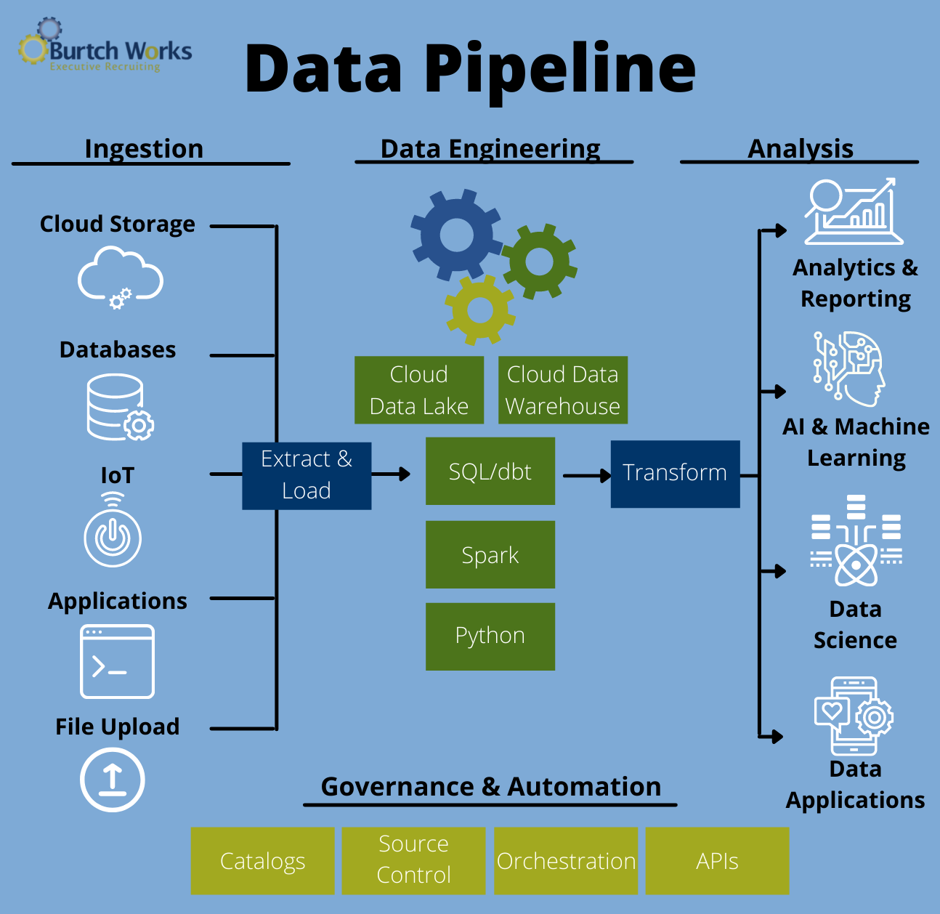

INTRODUCTION
Data Engineering involves three things
Data Ingestion & storage
Performing ETL operations
Data Analysis
The image has been taken from https://www.burtchworks.com/2021/10/11/rise-of-the-data-engineer-tools-skills-and-the-future-of-big-data/

Slide 3
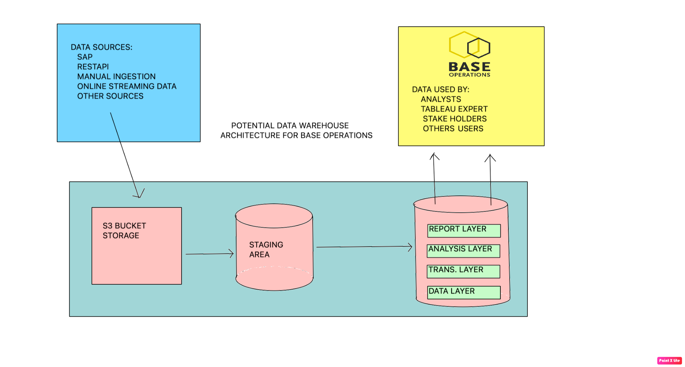
POTENTIAL DATA WAREHOUSE ARCHITECTURE DESIGN
Postgres DB

Slide 4
Data Warehouse Architecture Design Explanation
The architecture is very simple.
Collecting data from various sources
Storing in cloud storage ( S3 bucket in case of AWS)
Crawling the data into staging area, the data in the staging area would be exact replica of s3 bucket.
Next step is to normalize, rationalize and transform the data with the help of Glue ETL jobs and parse the data between different layers
Lastly using the transformed data for analysis and report generation to be done by different users of data.

Slide 5
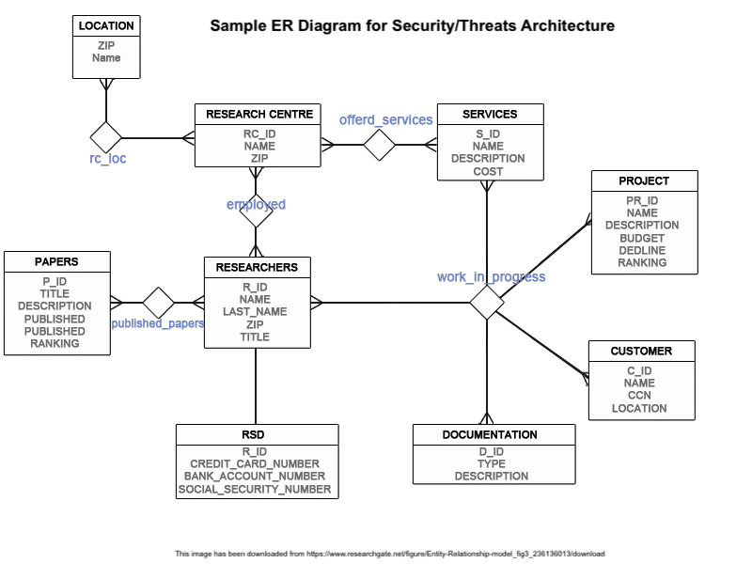
Entity Relationship Diagram
This is a sample diagram for security/threat model taken from internet. A similar diagram can be made for Base Operations.

Slide 6
ADDITIONAL CONSIDERATIONS
Mature Data Acquisition
It involves Data Exploration of the collected data. A framework can be made by Matillion ETL to do reporting on ad-hoc query basis.
Understanding the business acumen and targeting the right audience is important. Base operation uses threat intelligence to provide useful insights to various companies (target audience)
In order to use threat intelligence, data from external sources can be used. However, checks and balances like end -to -end testing should be done to make sure data quality.

Slide 7
ADDITIONAL CONSIDERATIONS
Data Preparation and Quality Checks
Quality checks are very essential as inaccurate data would lead to inaccurate results.
Data preprocessing and cleansing is required. The different layers in the database would ensure correct data transformation.
Unit test, functional testing and end-to-end testing can be done to ensure no data loss during transformation.
PyTest, Unittest, Robot are some of the python frameworks which can be used.
A sample unit test python code along with unit test documentation has been attached for better understanding.

Slide 8
ADDITIONAL CONSIDERATIONS
Defect Triage
Triage is really important as it helps in understanding the severity of the defect.
With the help of JIRA, one can track down the time taken to solve the defect and also can keep a track of priority issues or bug fixes to be done at the earliest.
In case of Agile methodology, triage report can be created and discussed in the particular sprint and bug can be fixed by next release.
However, in case of CI/CD, bugs fixing can be done quickly as the code would directly go into production right after development and testing.

Slide 9
ADDITIONAL CONSIDERATIONS
Error and Performance Considerations
Error handling can be done by the help of unit testing at every step.
Performance handling can be done by optimizing our ETL processes. We should trigger our workflows such that failure in one doesn’t result in failure of all the other jobs.
Further, we need to keep in mind the data redundancy and cost for running these processes.
A schedule to run the jobs (daily/monthly/weekly) depending on the can be set depending on the business requirement in UTC time.

Slide 10
ADDITIONAL CONSIDERATIONS
SNS Alerts and Notifications
With the help of Amazon Cloud Watch, SNS alerts can be sent in case of failure or error while running any process.
As logs helps to keep the track of recent run jobs, one can go back and inspect the cause of the job failure and can take steps to fix it.

Slide 11
Thank You!!
Have a nice day!!

